Slide 1



Tract-analysis and connectivity
Eleftherios Garyfallidis, PhD
Diffusion Imaging in Python
http://dipy.org
Sherbrooke Connectivity Imaging
Laboratory http://scil.dinf.usherbrooke.ca

Slide 2
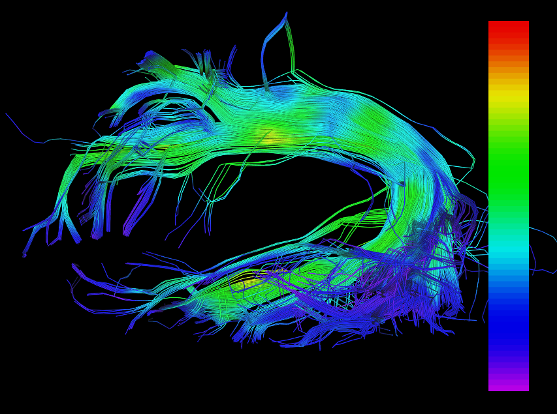

Introduction to tract-analysis
A tract is one of brain’s
superhighways
known from anatomy
A bundle is an
approximation of a tract
using a set of streamlines
Metrics/Maps
FA, AFD, MD etc.
Bundle maps
Connecting streamlines to maps
Streamlines and metrics in the “same” space (native space).
Streamlines and metrics are in different space but still having the transformation from the one to the other.
By interpolating the metric values on the points of the streamlines we can start talking about bundle integrity
Tract-analysis and connectivity - Eleftherios Garyfallidis (2015)

Slide 3
Streamlines and images
(x, y, z)
(i, j, k)
Streamlines are polylines (a series of line segments) where their points are in floating point coordinates (x=10.3, y=10.5, z=1.8).
This is in contrast to the image coordinates which are integer coordinates (i=10, j=11, k=2).
An affine transformation (4x4 transformation matrix) is needed to go from streamline coordinates to image coordinates. Given e.g. from the Nifti file.
Common file formats for streamlines are Trackvis (*.trk), *.vtk, *.tck etc.
Common file formats for metrics is Nifti (*.nii.gz, *.nii)
Warning! Make sure you understand the space of the streamlines in comparison to the
space of the images and how to go from the one space to the other. Familiarize yourself
with RAS 1mm, LAS, LPS etc.
Warning! Know your voxel origin. Is it in the center of the voxel (e.g. Nifti) or in the corner of the voxel (e.g. Trackvis).
Tract-analysis and connectivity - Eleftherios Garyfallidis (2015)

Slide 4
Why streamlines are useful?
20
2
1
They integrate information along many voxels
They contain connectivity information
They can tell us about shape and orientation
Warning! The order of the points between two
streamlines can be the reverse even in the
same bundle.
20
2
1
1
19
Warning! These are discrete 3D curves. Difficult to set
coordinate systems along 3D curves. Torsion
and curvature are error prone.
20
Warning! Many points… computationally expensive.
Warning! There is no essence of neighborhood of streamlines
without setting a distance between streamlines.
Tract-analysis and connectivity - Eleftherios Garyfallidis (2015)

Slide 5
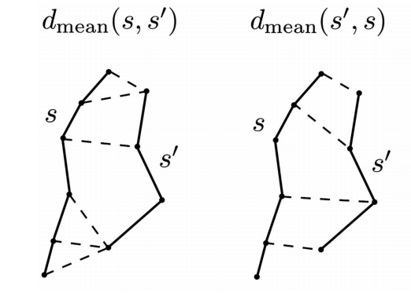
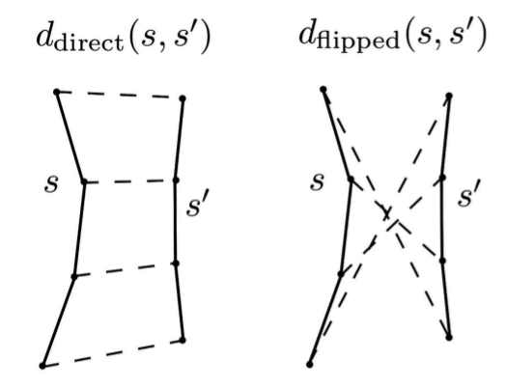
Streamline distances – which one to use ?
Haussdorff distances
Computationally expensive
Can put together streamlines of different length.
Streamlines can have different numbers of points
Vector-like distances
Points are now arrays of
fixed size.
Separate streamlines
of different length.
Tract-analysis and connectivity - Eleftherios Garyfallidis (2015)

Slide 6
Streamline distances – which one to use ?
Minimum Direct Flipped (MDF) distance
Garyfallidis et al., Frontiers 2012
min(ddirect, dflipped)
Fast to compute
Symmetric
Metric distance
Values from 0 to Inf in millimetres
Interpolation along the length is necessary
with fixed number of points. Recommended numbers
are from 12 to 20.
Lower MDF
Higher MDF
Tract-analysis and connectivity - Eleftherios Garyfallidis (2015)

Slide 7
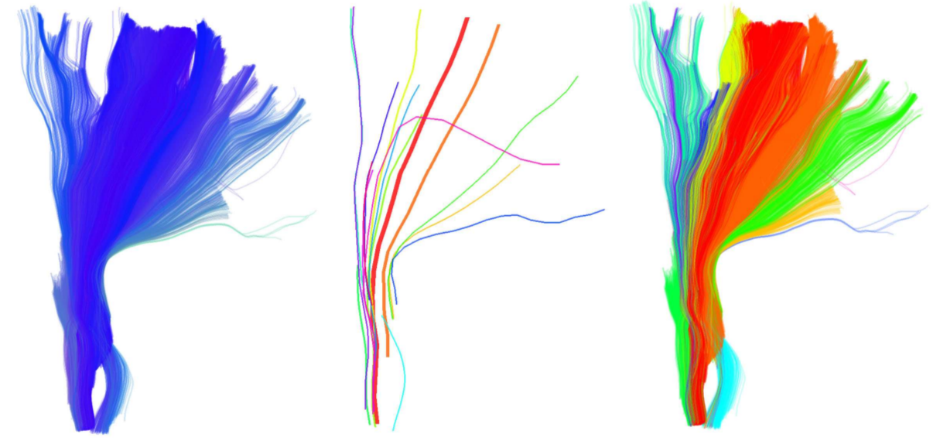
QuickBundles for Simplification
Using Minimum Direct Flipped (MDF) and
the QuickBundles clustering algorithm
Garyfallidis et al., Frontiers 2015
You will be able to identify hidden areas of
your datasets and simplify the computational
load of of processing streamlines.
An easy way to get
Centroids
Clusters
Using a single distance threshold (mm)
Very fast!
initial
centroids
clusters
Alert! This is unsupervised learning. Do not expect to get anatomically relevant clusters as a neuroanatomist would define them. Especially in the case of a whole brain tractography.
Alert! For anatomically relevant bundles you need to use supervised learning i.e. have a model of the bundles that you are looking for.
For other clustering algorithms / distances see the work of Guevara, O’Donnell and Corouge.
Tract-analysis and connectivity - Eleftherios Garyfallidis (2015)

Slide 8
Table of contents for tract analysis
Segmentation of streamlines
Manual
Automatic
Semi-automatic
Registration
Image-based (old school) covered by Konstantinos
Streamline-based (new) brings many new capabilities
Subject level tractometry
Statistics of metrics along bundles
Perpendicular to bundles
Group level tractometry
New and exciting
Tract-analysis and connectivity - Eleftherios Garyfallidis (2015)

Slide 9
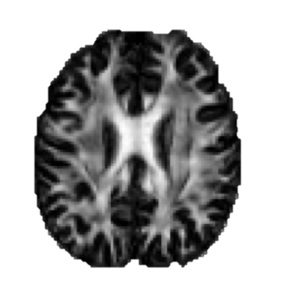
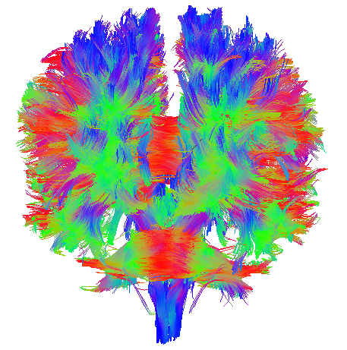
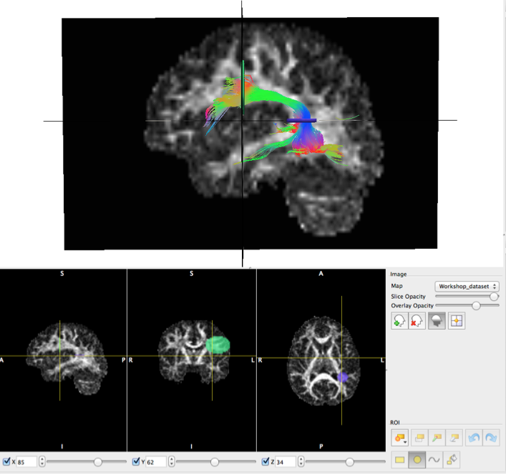
Manual segmentation
Types of ROIs:
Inclusion (logical “and” and “or”)
Exclusion (logical “not”)
How we use ROIs:
Termination Points (e.g. Cortical)
Waypoints (e.g. specific white matter region)
Volumetric (e.g. U-Shape)
Available tools:
Trackvis, Fibernavigator and MI-Brain
Tract-analysis and connectivity - Eleftherios Garyfallidis (2015)

Slide 10
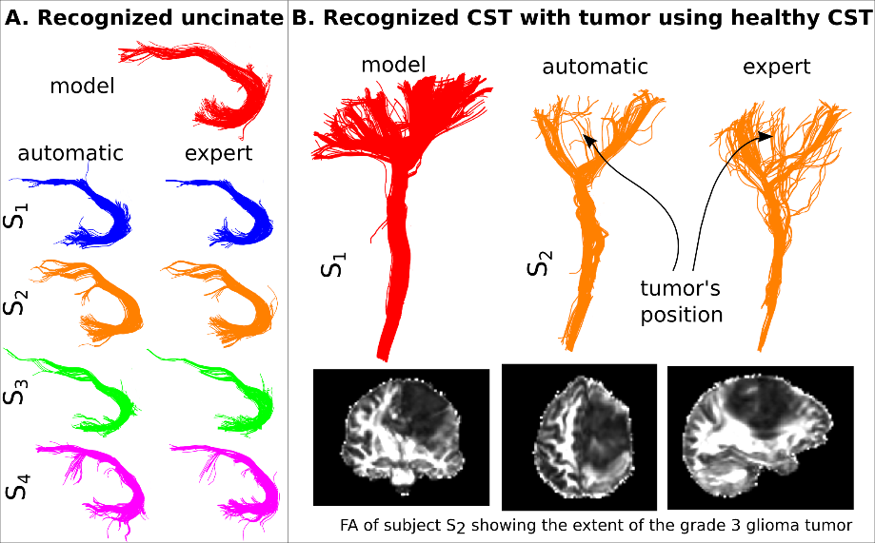

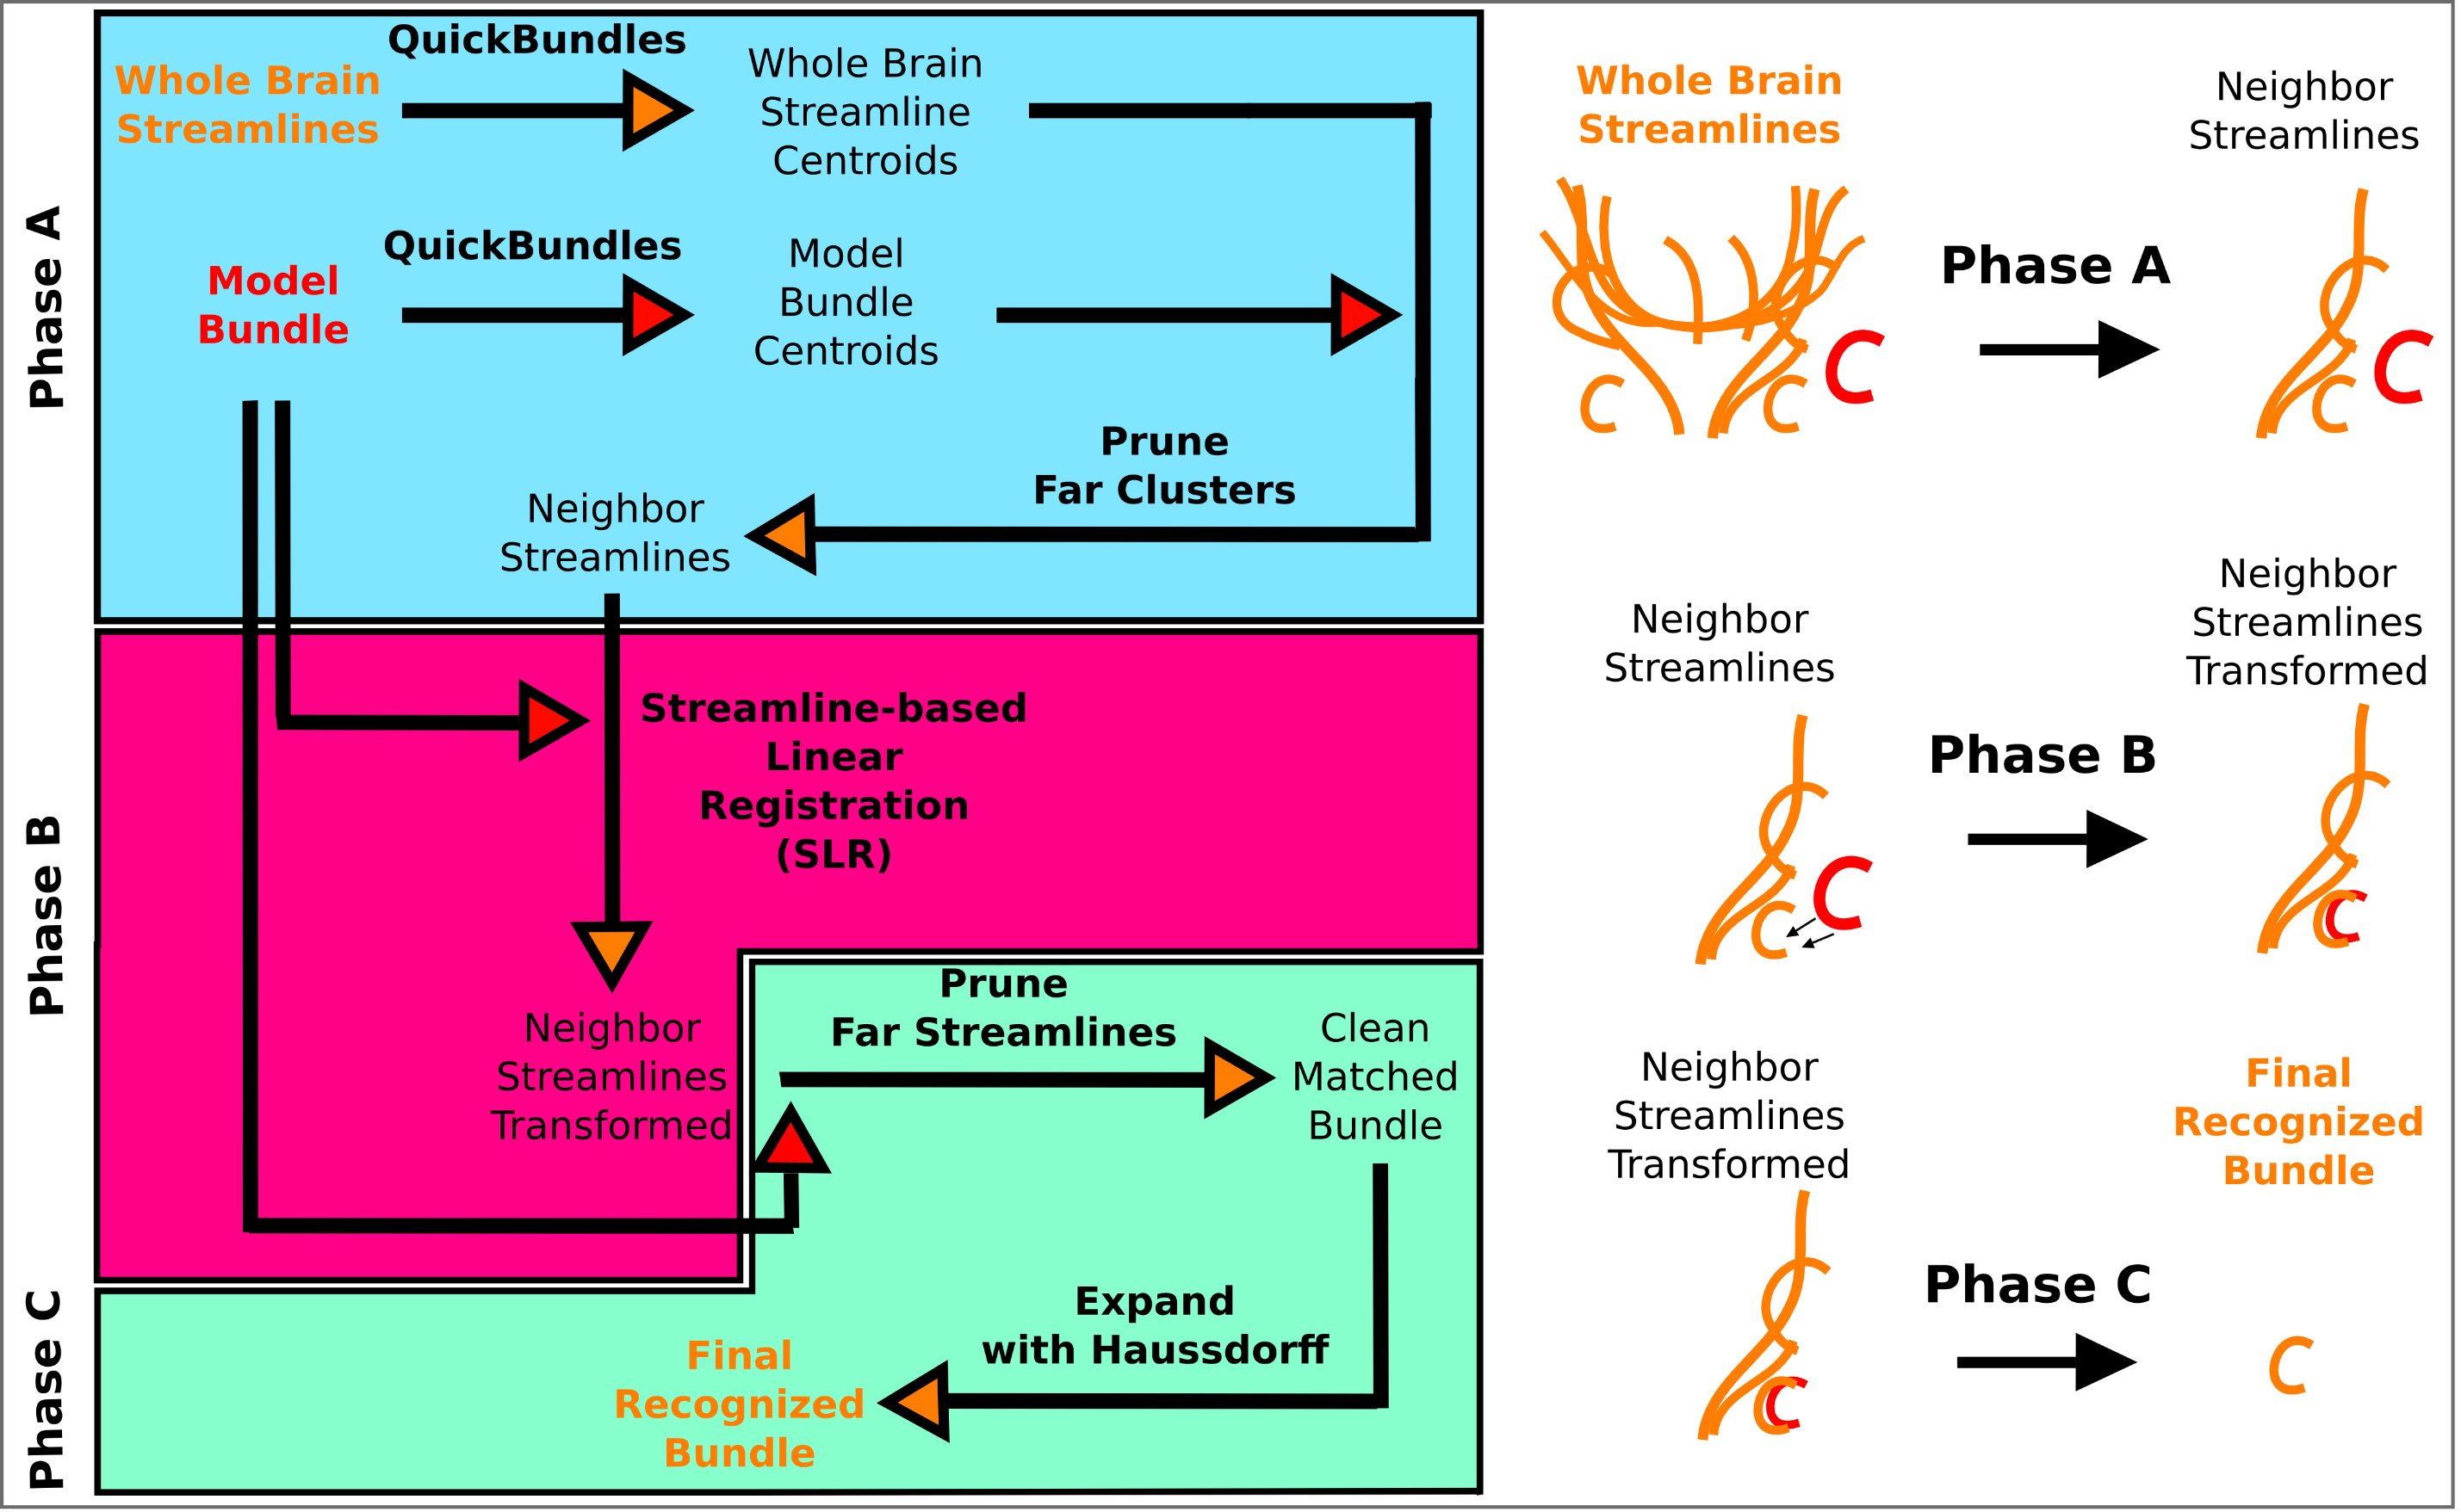
Automatic Segmentation
Garyfallidis et al., Recognition of bundles in healthy and severely diseased brains, ISMRM 2015.
Tract-analysis and connectivity - Eleftherios Garyfallidis (2015)

Slide 11
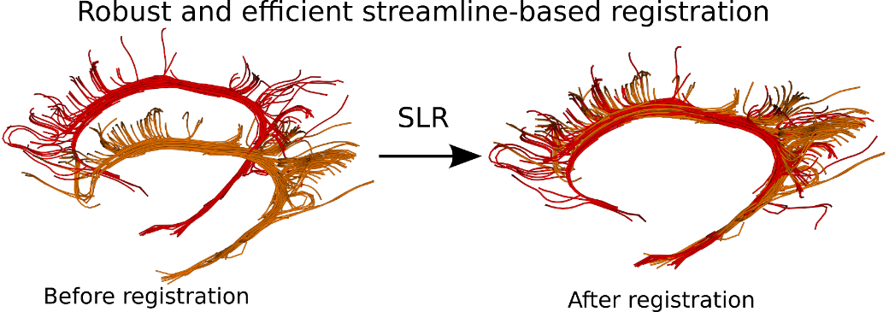
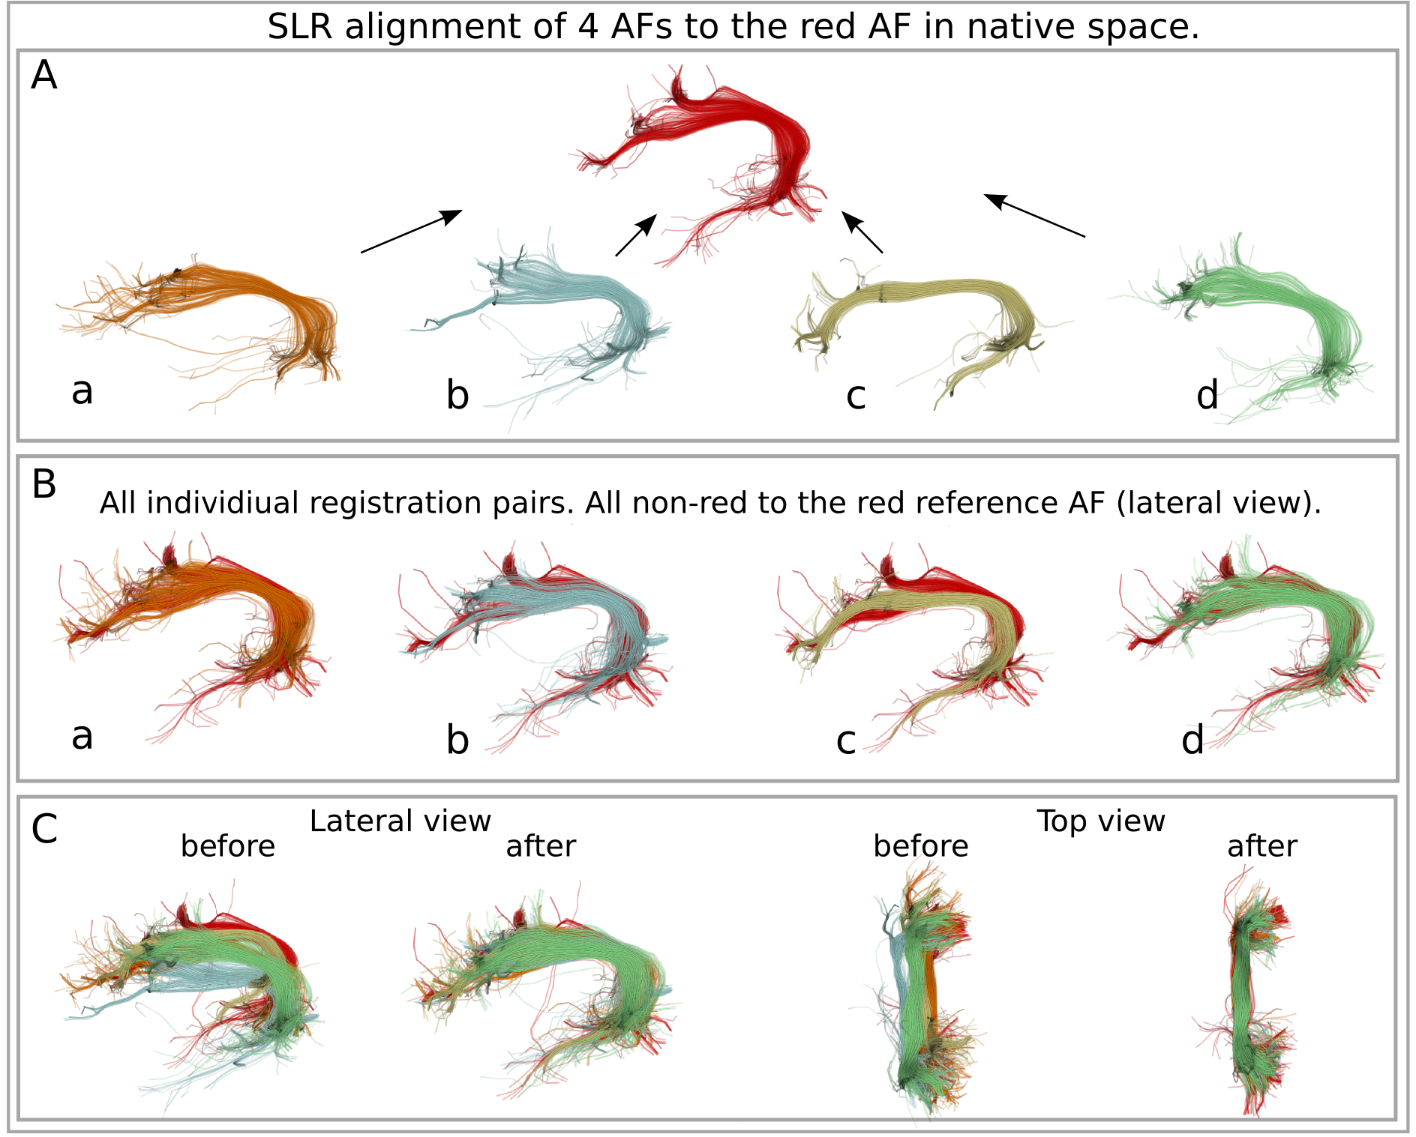
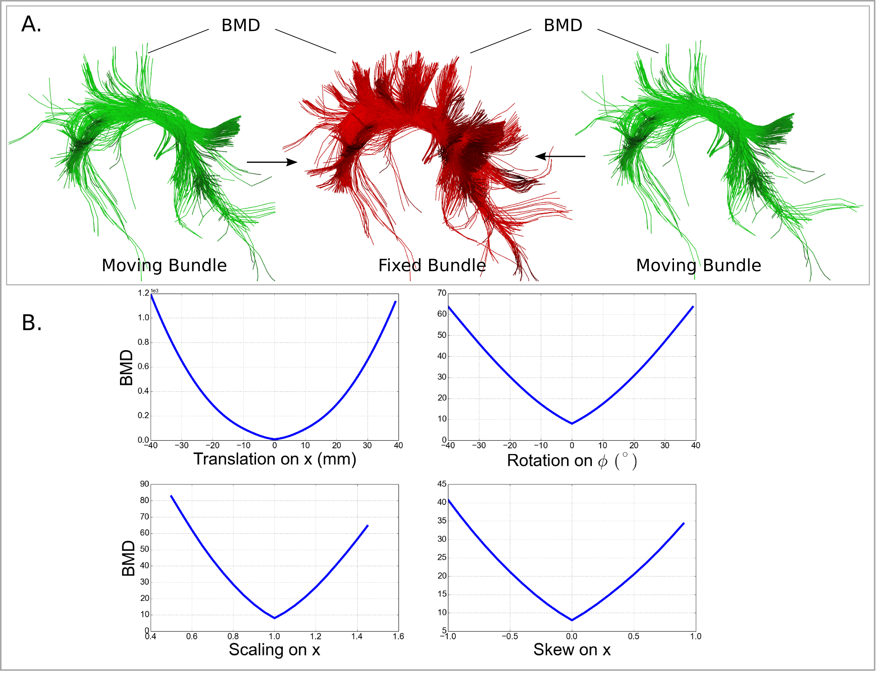
Registration of bundles
The Streamline-based Linear registration (SLR)
is very robust to incomplete data.
Garyfallidis et al. Robust and efficient linear registration of
fascicles in the space of streamlines, Neuroimage (2015)
Tract-analysis and connectivity - Eleftherios Garyfallidis (2015)

Slide 12
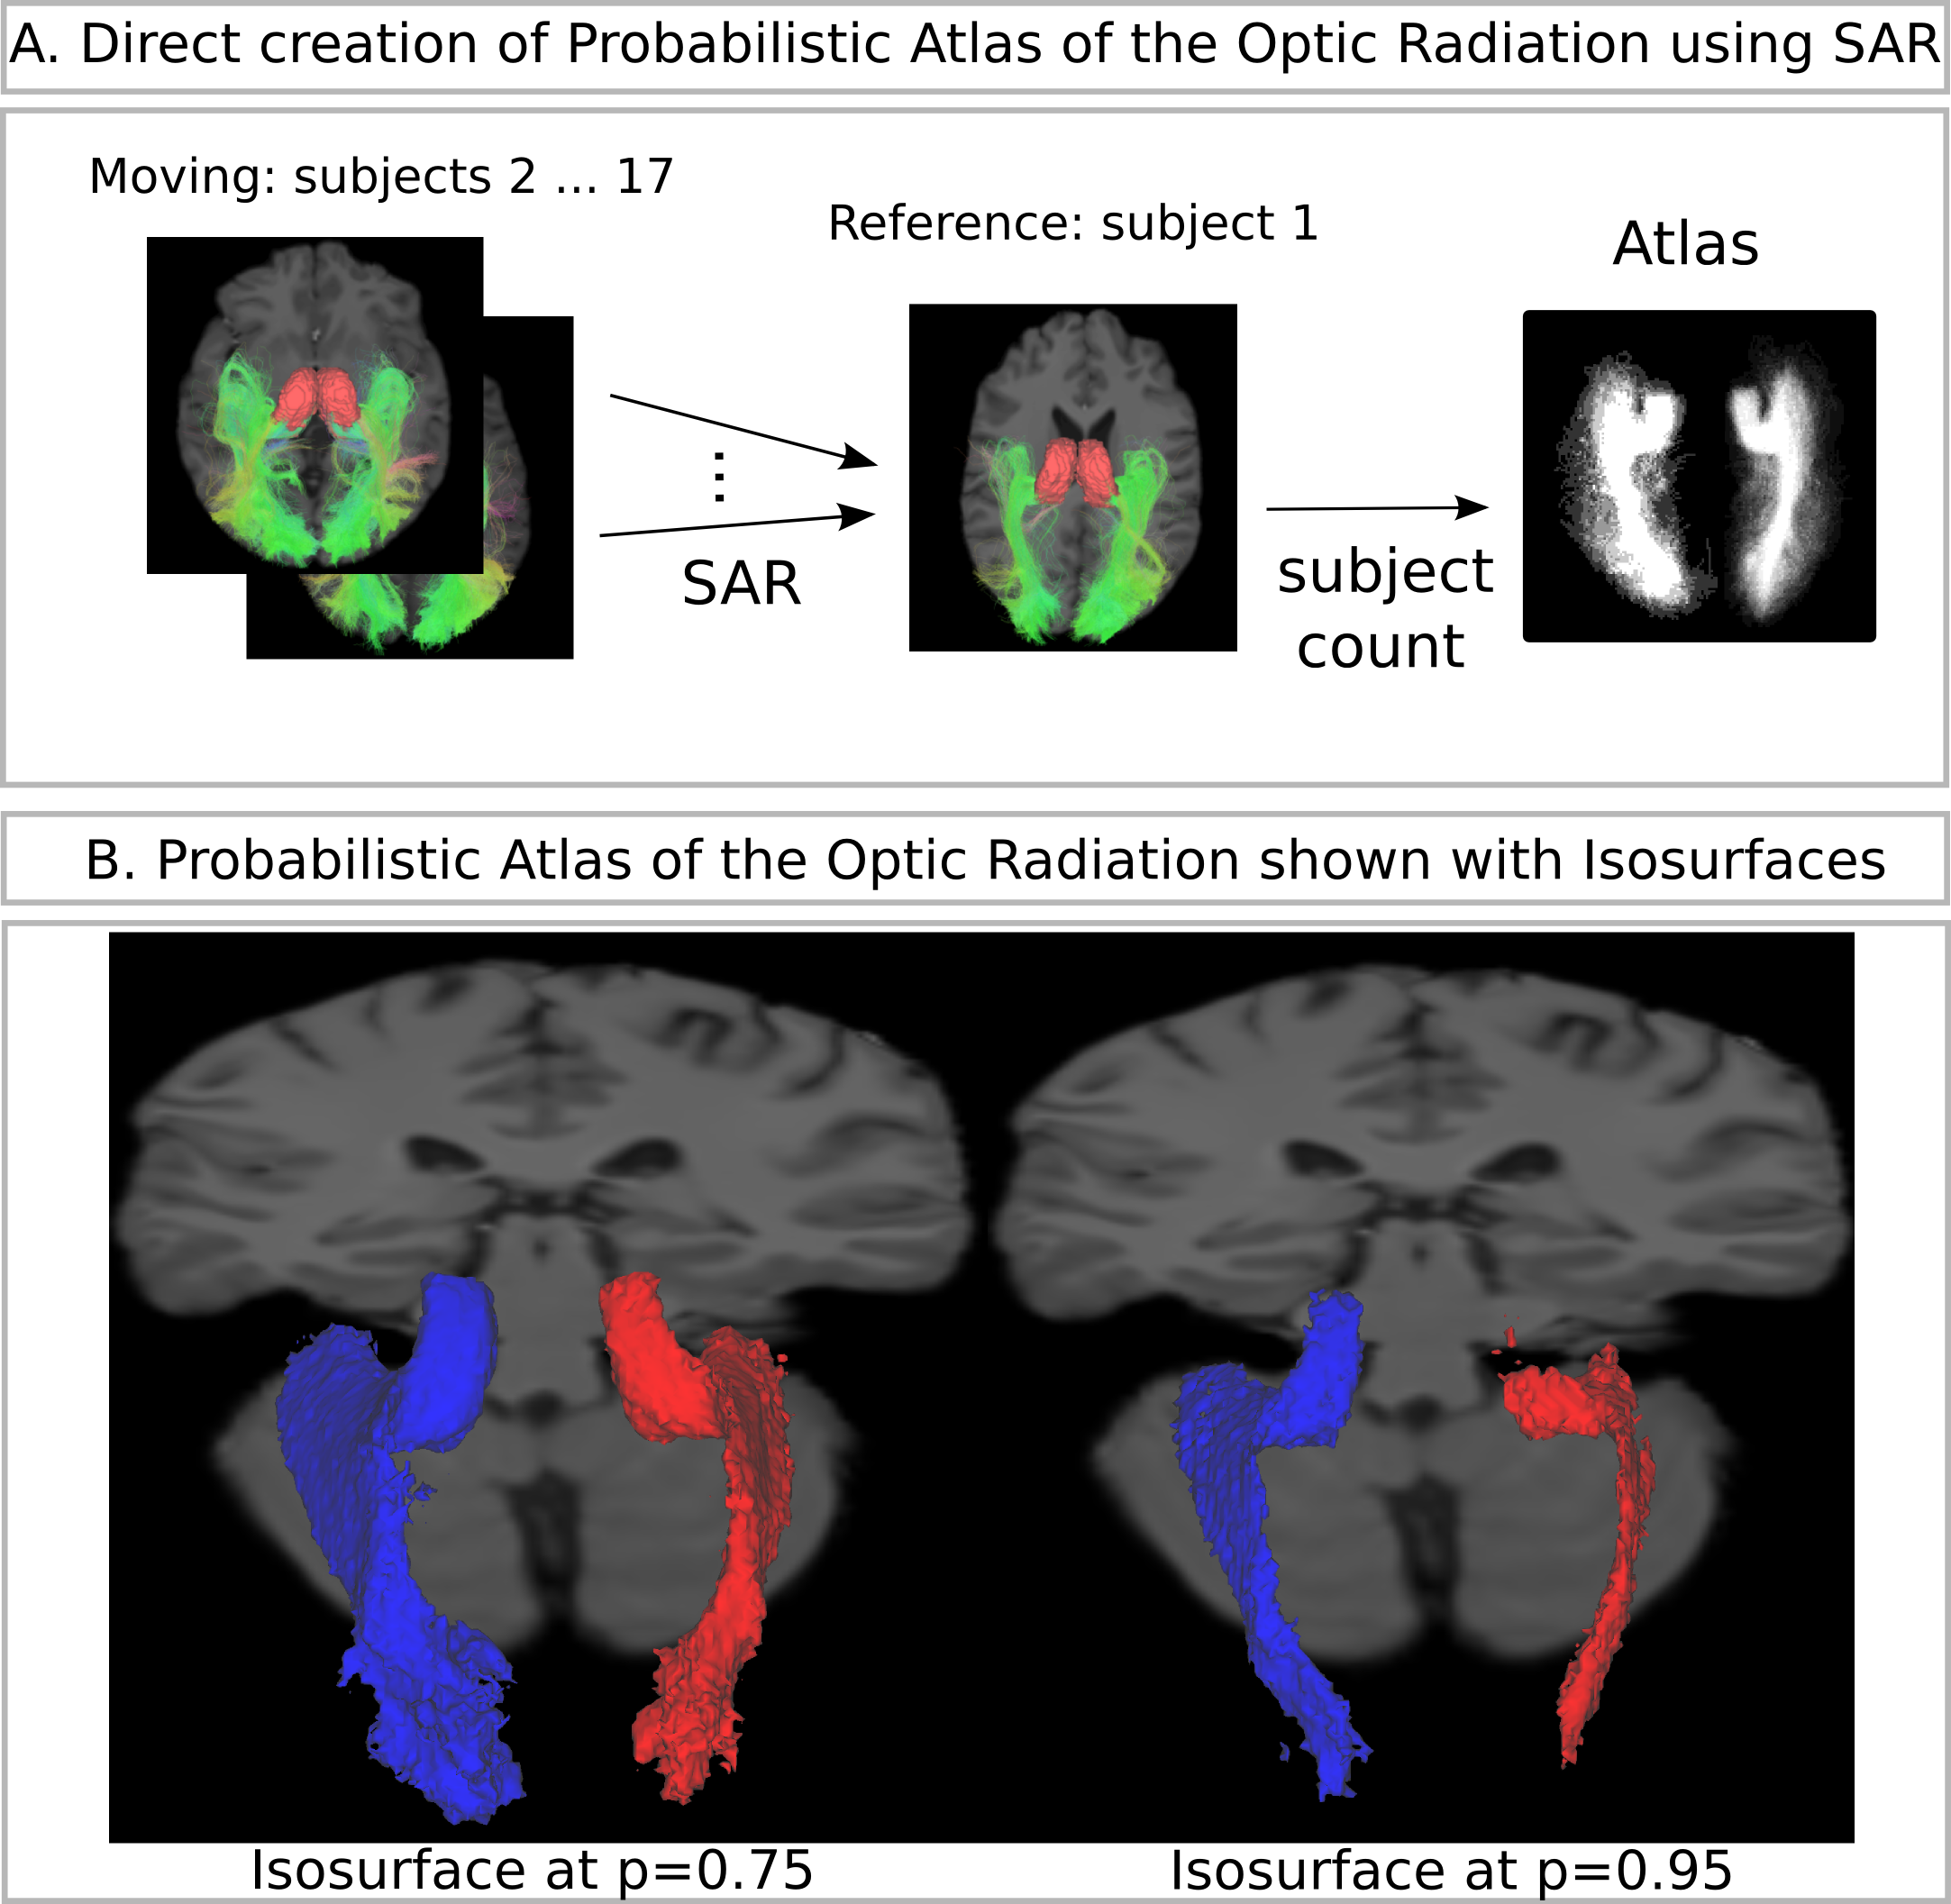
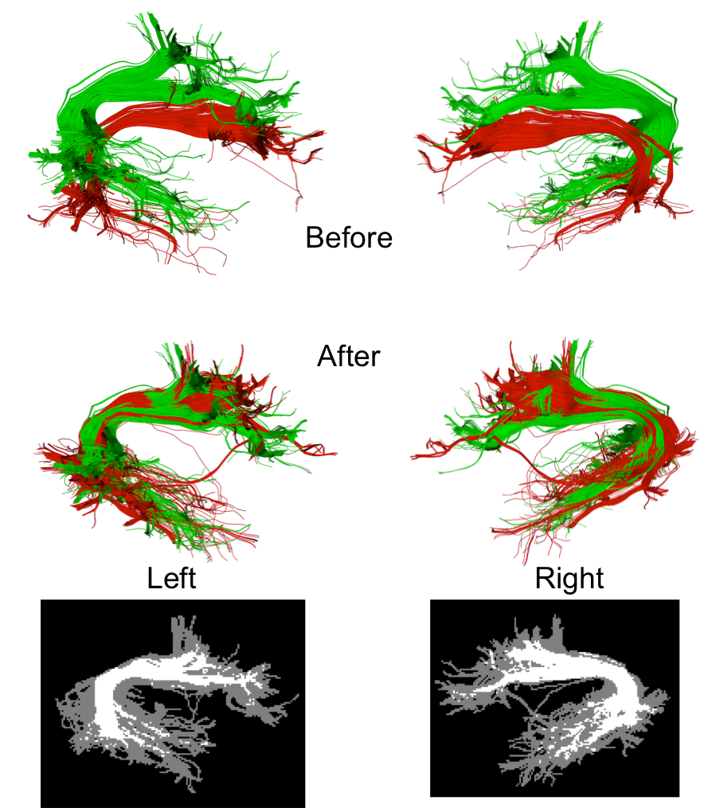
Create bundle-specific atlases using SLR
Find overlaps between bundles
Atlas of the Optic Radiation
Garyfallidis et al., Neuroimage (2015)
Tract-analysis and connectivity - Eleftherios Garyfallidis (2015)

Slide 13
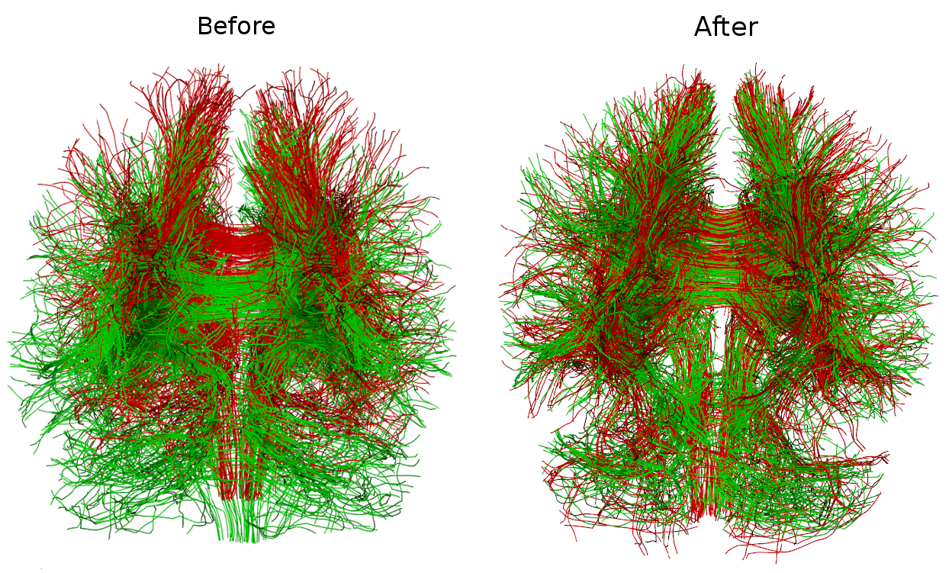
Whole-brain linear registration of streamlines
Garyfallidis et al. Robust and efficient linear registration of
fascicles in the space of streamlines, Neuroimage (2015)
Tip! In very diseased brains e.g. with large tumors or stroke even image-based linear registration can fail. Use this method instead. Register the streamlines not the images.
Tract-analysis and connectivity - Eleftherios Garyfallidis (2015)

Slide 14
Table of contents for connectivity
Cortical surface
Connect with cortical surface
Connect with sub-cortical areas
Connectivity
Understand the basics of graph theory.
Be critical with counting streamlines.
An example of good counting with the tractometer.
Tract-analysis and connectivity - Eleftherios Garyfallidis (2015)

Slide 15
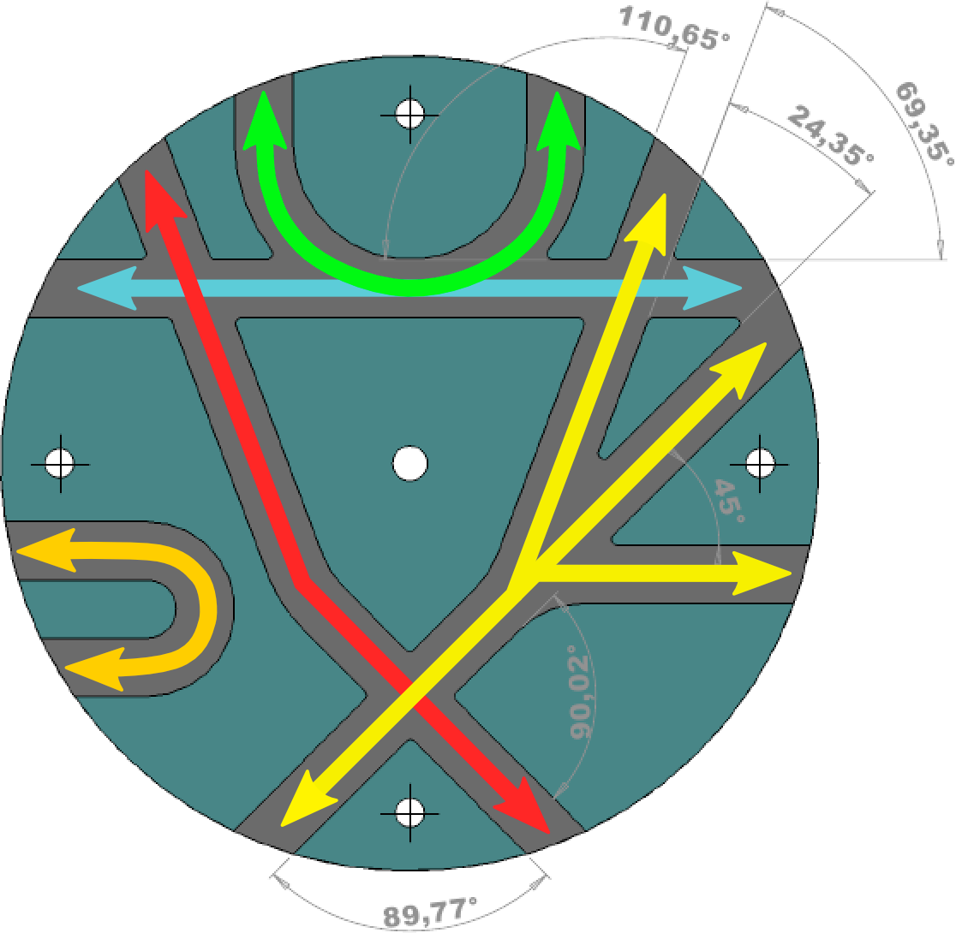
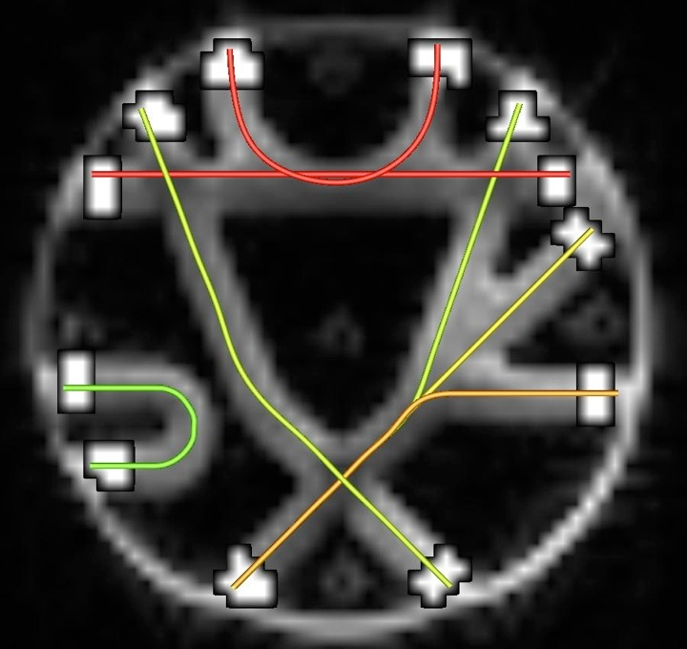
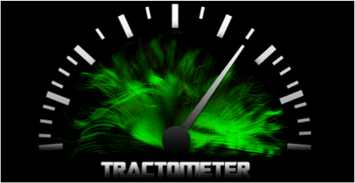
Connectivity analysis (the good guys)
Valid connections and valid paths
Fiber Cup Phantom
Tract-analysis and connectivity - Eleftherios Garyfallidis (2015)

Slide 16
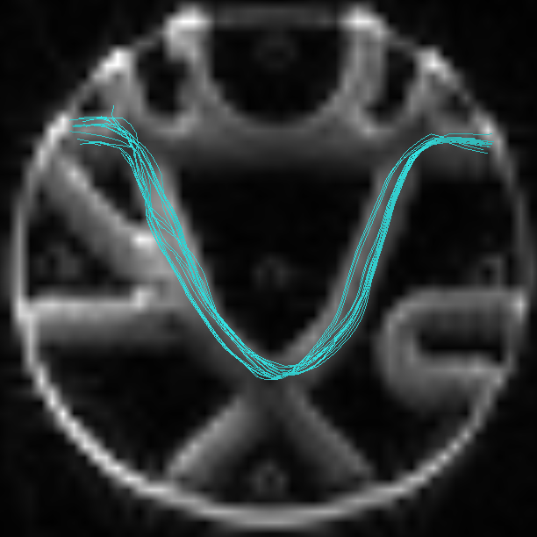
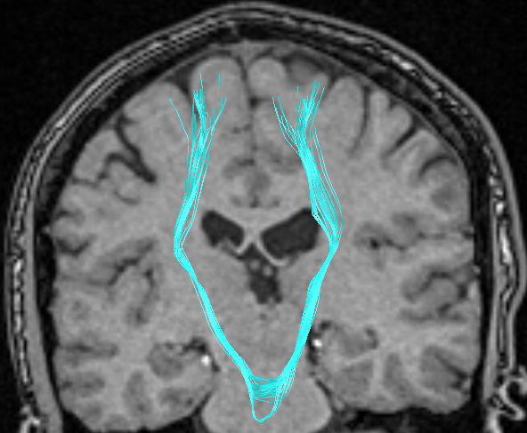
Connectivity analysis (bad guys)
Valid connections but wrong path
Tract-analysis and connectivity - Eleftherios Garyfallidis (2015)

Slide 17
Connectivity analysis (more bad guys)
Invalid connections – connects two regions that shouldn’t be connected
Tract-analysis and connectivity - Eleftherios Garyfallidis (2015)

Slide 18
Connectivity analysis (and the ugly)
Does not connect two end regions – stops prematurely in ventricles or mask
Tract-analysis and connectivity - Eleftherios Garyfallidis (2015)

Slide 19
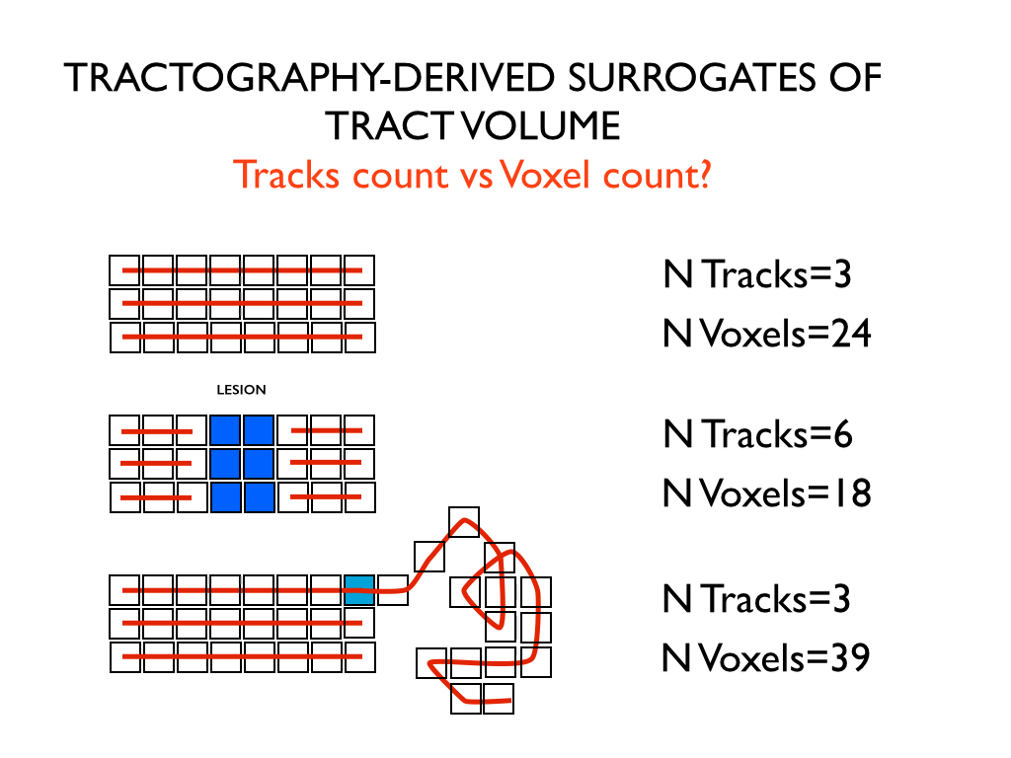
Alert for connectivity analysis! Be critical when counting streamlines
Courtesy of Marco Catani
Tract-analysis and connectivity - Eleftherios Garyfallidis (2015)

Slide 20
Lessons from the ISMRM 2015 challenge
Voxel perfect alignment with the T1 is necessary
Motion can push your connectivity results massively
We need more accurate ways of measuring connectivity
Solution! Use model bundles to measure your connectivity.
Now valid connections are the bundles which are close to the model
bundle up to a distance threshold.
This technique does not require voxel perfect alignment and can
deal with small warps.
Tract-analysis and connectivity - Eleftherios Garyfallidis (2015)

Slide 21

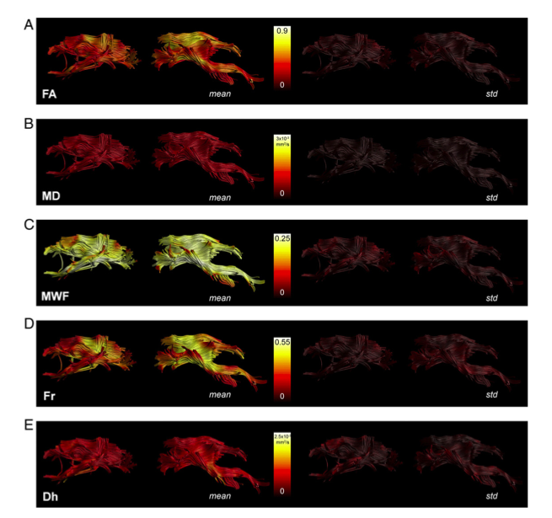
Tractometry
FA₅
FA_{n-1}
FA₄
FA₃
FA₂
FA₁
Bells et al. ISMRM 2012, Assaf et al. Neuroimage 2013,
Catani et al, PNAS 2007, Lebel & Beaulieu HBM 2009, Forkel et al Brain 2014
Tract-analysis and connectivity - Eleftherios Garyfallidis (2015)

Slide 22
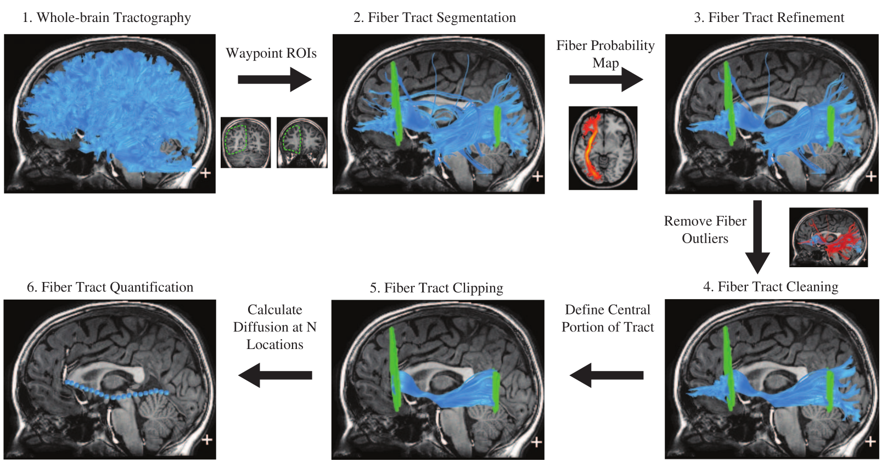
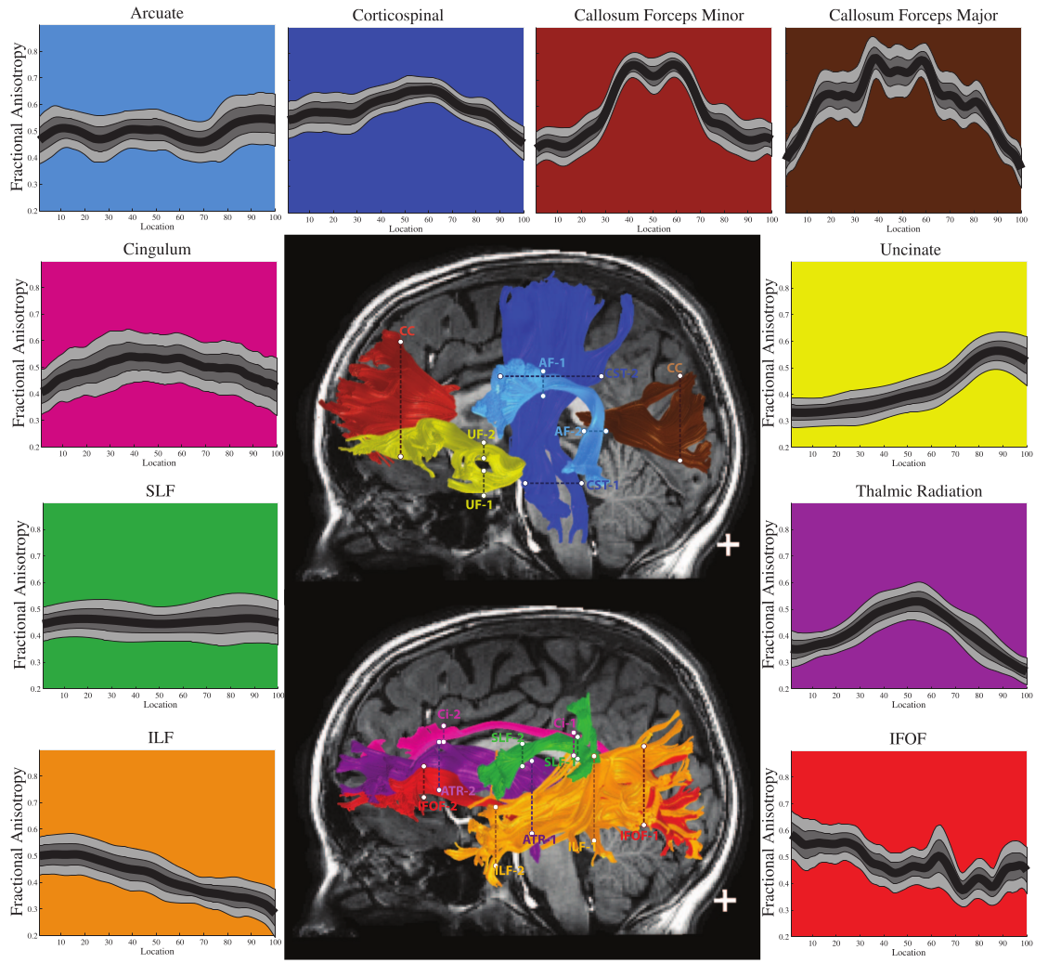
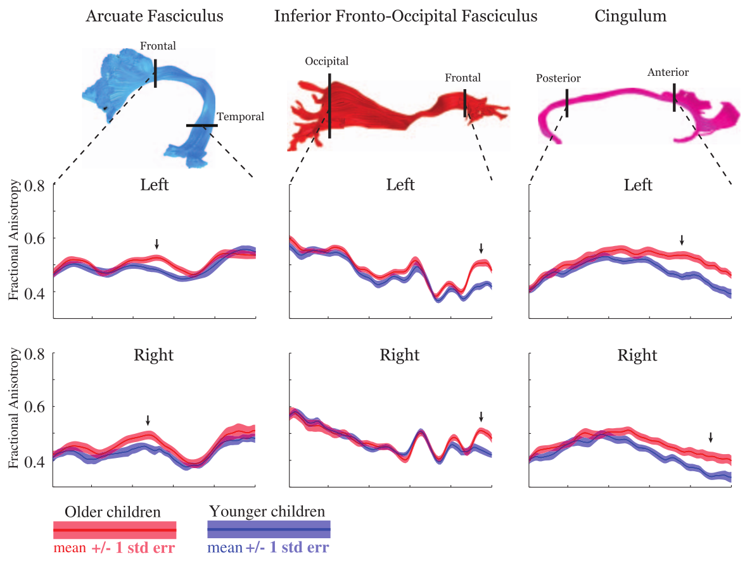
Apparent fiber quantification
Yeatman et al. PLoS 2012
Define planes in MNI space after
registering FA images with
nonlinear registration and project
the planes back in native space.
Tract-analysis and connectivity - Eleftherios Garyfallidis (2015)

Slide 23
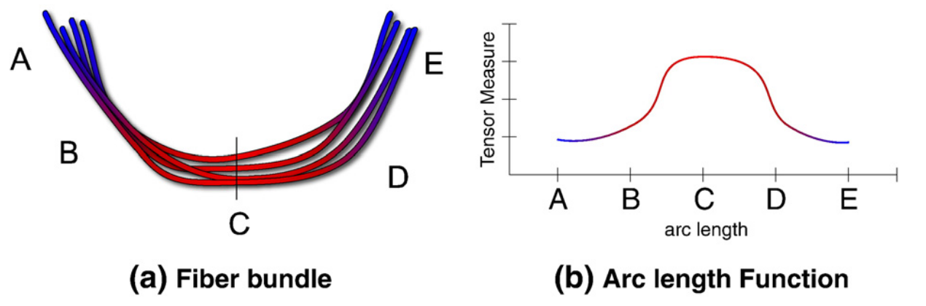
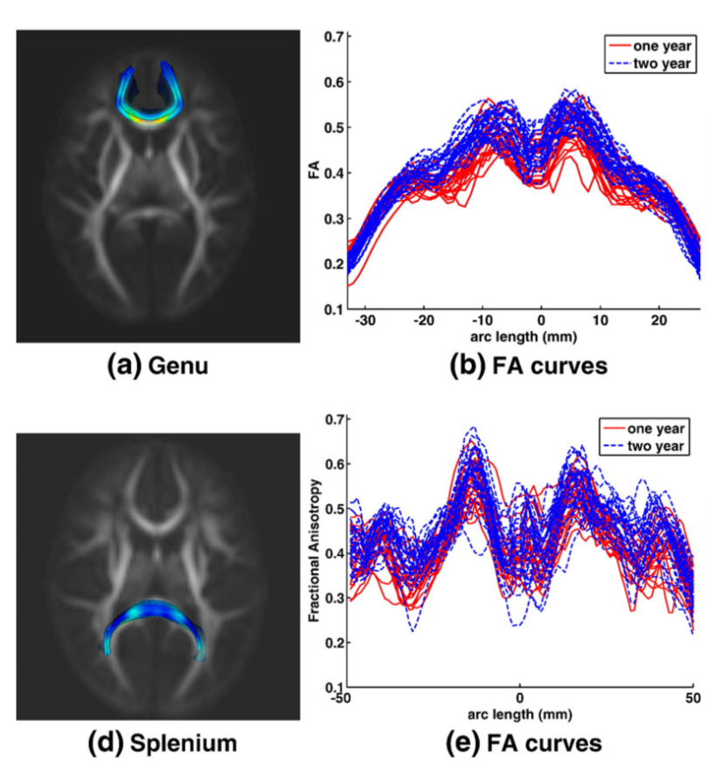
Functional data analysis
Goodlett et al. Neuroimage 2009
As it is difficult to compare directly
the arc length functions. The authors
Used functional data analysis to fit the
profiles as coefficients of B-splines.
And then use discriminant analysis
with the principal components of
the coefficients of these B-splines.
Tract-analysis and connectivity - Eleftherios Garyfallidis (2015)

Slide 24
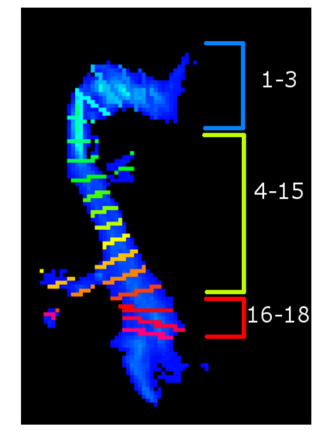
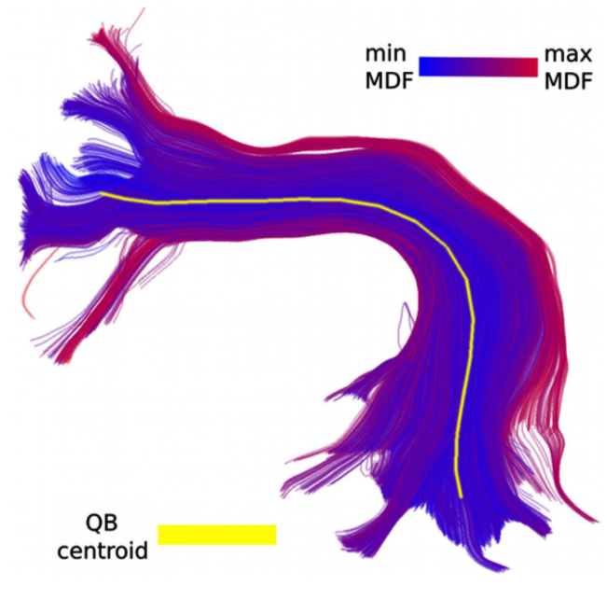
Measures along/from a centroid
Cross-sections along a centroid
Renauld et al., “Morphology of thalamus, LGN and optic radiation do not influence EEG alpha waves”, Brain function and structure (submitted), 2015
Distance maps from centroid
Tract-analysis and connectivity - Eleftherios Garyfallidis (2015)

Slide 25
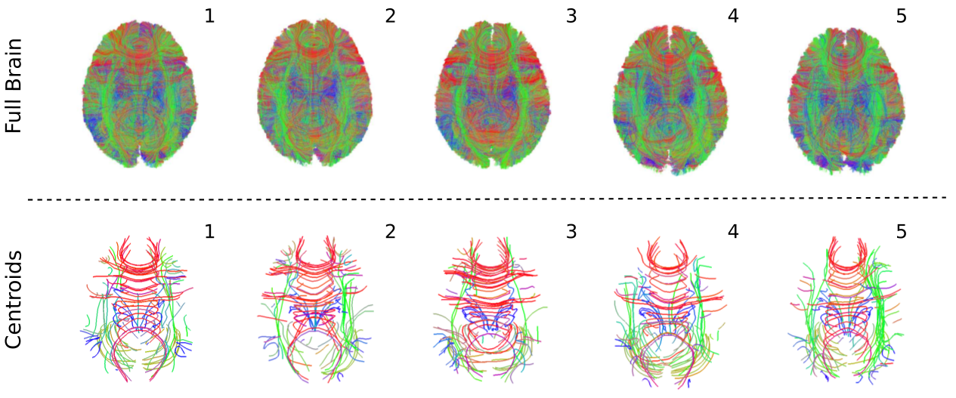
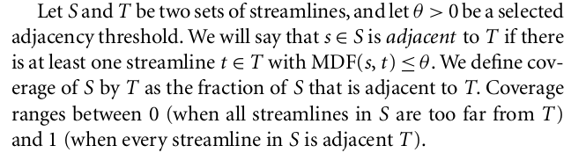
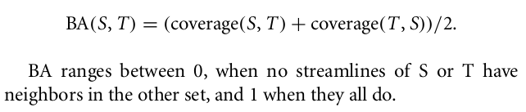
Comparing sets of streamlines for group comparisons (advanced)
Garyfallidis et al. PhD thesis,
Univ. of Cambridge, 2012
Bundle adjacency (BA) is a metric
for comparing how similar are
clusters between different subjects.
The streamlines of all subjects need
to be in the same space.
Tract-analysis and connectivity - Eleftherios Garyfallidis (2015)

Slide 26
Conclusion
Make the mental leap from images to streamlines. The grid is not everything!
The world of streamlines is a world of opportunity.
Automatic segmentation of streamlines is reducing manual segmentation.
Registration of bundles is also very powerful.
Clustering/simplification can show you hidden structures
and reduce computational complexity.
Study the bundles using centroids, distances, clusters, cross-sections and tell us more about the brain.
Do not stick only to Tensor metrics move to AFD, QA and other newer measures. Get into microstructural measures along the bundles.
Nearly all the tools shown in this course are available in Diffusion Imaging in Python.
Find me in the DIPY booth for more information.
Tract-analysis and connectivity - Eleftherios Garyfallidis (2015)

Slide 27
Thank you for your attention!
Tract-analysis and connectivity - Eleftherios Garyfallidis (2015)

